Slide 1


Gilang Islamay
18 February 2024

Slide 2

Outline
Executive Summary
Introduction
Methodology
Results
Conclusion
Appendix

Slide 3
Executive Summary
Summary of methodologies
Summary of all results

Slide 4
Introduction
Project background and context
Problems you want to find answers

Slide 5

Section 1

Slide 6
Methodology
Executive Summary
Data collection methodology:
Through API and Web Scarping!
Perform data wrangling
One Hot Encoding!
Perform exploratory data analysis (EDA) using visualization and SQL
Perform interactive visual analytics using Folium and Plotly Dash
Perform predictive analysis using classification models
Build, tune, and evaluate classification models!

Slide 7
Data Collection
Datasets were collected using two methods, which are
SpaceX Api
SpaceX Web Scraping using BeautifulSoup

Slide 8
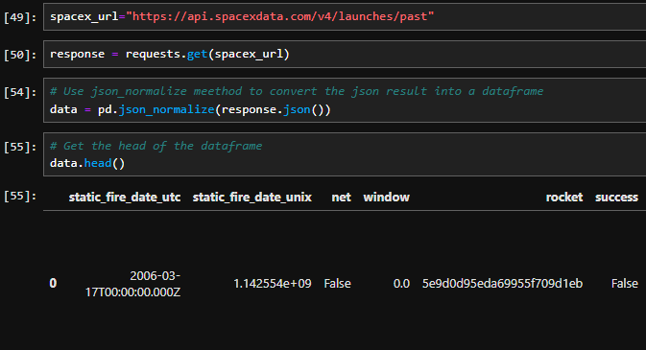
Data Collection – SpaceX API
We utilized the GET request with the SpaceX API to gather the data.
https://github.com/AfterRain007/TFDS/blob/main/Finale/1%20jupyter-labs-spacex-data-collection-api.ipynb

Slide 9
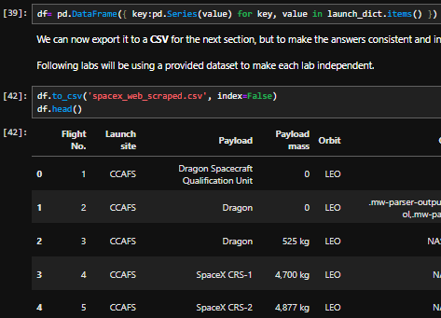
Data Collection - Scraping
We employed web scraping techniques to extract Falcon 9 launch records from a webpage using BeautifulSoup. After parsing the table, we are able to transformed the data into a pandas dataframe.
https://github.com/AfterRain007/TFDS/blob/main/Finale/1%20jupyter-labs-webscraping.ipynb

Slide 10
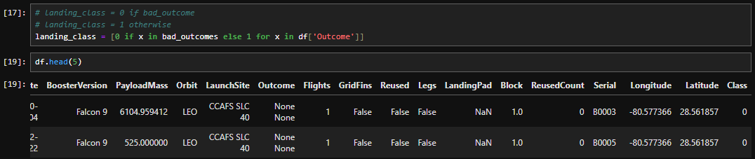
Data Wrangling
Before going into Exploratory Data Anlysis, etc etc. First thing first we need to do some Data Wrangling! Let’s Create a landing outcome label from Outcome column, where we set 0 to the bad outcome and 1 if it’s otherwise. We can achieve this by doing simple list comprehension.

Slide 11
EDA with Data Visualization
Now, let’s explore the data to better understand it’s value. There’s a couple chart that we plotted, which are
Scatter Plot
Line Plot
Bar Plot
We use these chart to better understand the correlation between two variable!
https://github.com/AfterRain007/TFDS/blob/main/Finale/4%20jupyter-labs-eda-dataviz.ipynb

Slide 12
EDA with SQL
Not only with pandas, we can use SQL too in Jupyter Notebook! In this example we load the SpaceX dataset into a PostgreSQL database and gain some insight from the dataset!
https://github.com/AfterRain007/TFDS/blob/main/Finale/5%20jupyter-labs-eda-sql-coursera_sqllite.ipynb

Slide 13
Build an Interactive Map with Folium
How does one build a map? Let alone in python? Well, let me introduce you to Folium!
With Folium, we are capable of marking all the launch sites with markers, circles, and line! Where if there’s a high success rate based on the data in one launch site, we are able to make the colors to the said markers to be green.
https://github.com/AfterRain007/TFDS/blob/main/Finale/6%20lab_jupyter_launch_site_location.ipynb

Slide 14
Build a Dashboard with Plotly Dash
We can also build an interactive dashboard in Jupyter Notebook using Plotly Dash.

Slide 15
Predictive Analysis (Classification)
Summarize how you built, evaluated, improved, and found the best performing classification model
You need present your model development process using key phrases and flowchart
Add the GitHub URL of your completed predictive analysis lab, as an external reference and peer-review purpose

Slide 16
Results
Exploratory data analysis results
Interactive analytics demo in screenshots
Predictive analysis results

Slide 17

Section 2

Slide 18
Flight Number vs. Launch Site
Show a scatter plot of Flight Number vs. Launch Site
Show the screenshot of the scatter plot with explanations

Slide 19
Payload vs. Launch Site
Show a scatter plot of Payload vs. Launch Site
Show the screenshot of the scatter plot with explanations

Slide 20
Success Rate vs. Orbit Type
Show a bar chart for the success rate of each orbit type
Show the screenshot of the scatter plot with explanations

Slide 21
Flight Number vs. Orbit Type
Show a scatter point of Flight number vs. Orbit type
Show the screenshot of the scatter plot with explanations

Slide 22
Payload vs. Orbit Type
Show a scatter point of payload vs. orbit type
Show the screenshot of the scatter plot with explanations

Slide 23
Launch Success Yearly Trend
Show a line chart of yearly average success rate
Show the screenshot of the scatter plot with explanations

Slide 24
All Launch Site Names
Find the names of the unique launch sites
Present your query result with a short explanation here

Slide 25
Launch Site Names Begin with 'CCA'
Find 5 records where launch sites begin with `CCA`
Present your query result with a short explanation here

Slide 26
Total Payload Mass
Calculate the total payload carried by boosters from NASA
Present your query result with a short explanation here

Slide 27
Average Payload Mass by F9 v1.1
Calculate the average payload mass carried by booster version F9 v1.1
Present your query result with a short explanation here

Slide 28
First Successful Ground Landing Date
Find the dates of the first successful landing outcome on ground pad
Present your query result with a short explanation here

Slide 29
Successful Drone Ship Landing with Payload between 4000 and 6000
List the names of boosters which have successfully landed on drone ship and had payload mass greater than 4000 but less than 6000
Present your query result with a short explanation here

Slide 30
Total Number of Successful and Failure Mission Outcomes
Calculate the total number of successful and failure mission outcomes
Present your query result with a short explanation here

Slide 31
Boosters Carried Maximum Payload
List the names of the booster which have carried the maximum payload mass
Present your query result with a short explanation here

Slide 32
2015 Launch Records
List the failed landing_outcomes in drone ship, their booster versions, and launch site names for in year 2015
Present your query result with a short explanation here

Slide 33
Rank Landing Outcomes Between 2010-06-04 and 2017-03-20
Rank the count of landing outcomes (such as Failure (drone ship) or Success (ground pad)) between the date 2010-06-04 and 2017-03-20, in descending order
Present your query result with a short explanation here

Slide 34

Section 3

Slide 35
<Folium Map Screenshot 1>
Replace <Folium map screenshot 1> title with an appropriate title
Explore the generated folium map and make a proper screenshot to include all launch sites’ location markers on a global map
Explain the important elements and findings on the screenshot

Slide 36
<Folium Map Screenshot 2>
Replace <Folium map screenshot 2> title with an appropriate title
Explore the folium map and make a proper screenshot to show the color-labeled launch outcomes on the map
Explain the important elements and findings on the screenshot

Slide 37
<Folium Map Screenshot 3>
Replace <Folium map screenshot 3> title with an appropriate title
Explore the generated folium map and show the screenshot of a selected launch site to its proximities such as railway, highway, coastline, with distance calculated and displayed
Explain the important elements and findings on the screenshot

Slide 38

Section 4

Slide 39
<Dashboard Screenshot 1>
Replace <Dashboard screenshot 1> title with an appropriate title
Show the screenshot of launch success count for all sites, in a piechart
Explain the important elements and findings on the screenshot

Slide 40
<Dashboard Screenshot 2>
Replace <Dashboard screenshot 2> title with an appropriate title
Show the screenshot of the piechart for the launch site with highest launch success ratio
Explain the important elements and findings on the screenshot

Slide 41
<Dashboard Screenshot 3>
Replace <Dashboard screenshot 3> title with an appropriate title
Show screenshots of Payload vs. Launch Outcome scatter plot for all sites, with different payload selected in the range slider
Explain the important elements and findings on the screenshot, such as which payload range or booster version have the largest success rate, etc.

Slide 42

Section 5

Slide 43
Classification Accuracy
Visualize the built model accuracy for all built classification models, in a bar chart
Find which model has the highest classification accuracy

Slide 44
Confusion Matrix
Show the confusion matrix of the best performing model with an explanation

Slide 45
Conclusions
Point 1
Point 2
Point 3
Point 4
…

Slide 46
Appendix
Include any relevant assets like Python code snippets, SQL queries, charts, Notebook outputs, or data sets that you may have created during this project

Slide 47


